Slide 1
.NET Objects
Adam Vincent
Notes:
Preface: When .NET Core 3.1/.NET Standard 2.0 I noticed a new shiny HashCode struct with a Combine() method was added and I wanted to learn a little more about it. So this presentation is about a perspective of what is equality from the ground up. There’s going to be a couple things out of scope for this presentation because frankly I don’t have enough knowledge to go much deeper in detail. I’m not going to cover Stack vs Heap or how .NET manages memory or anything about garbage collection. I hope to include these things in the future as I explore more things that are indeed relevant.

Slide 2
What’s an object?
When you write code to define your own class, your class is a blueprint for a block of memory. The blueprint or class declaration is referred to as a type
A block of memory is allocated and configured by your type, and is called an object, or instance

Slide 3
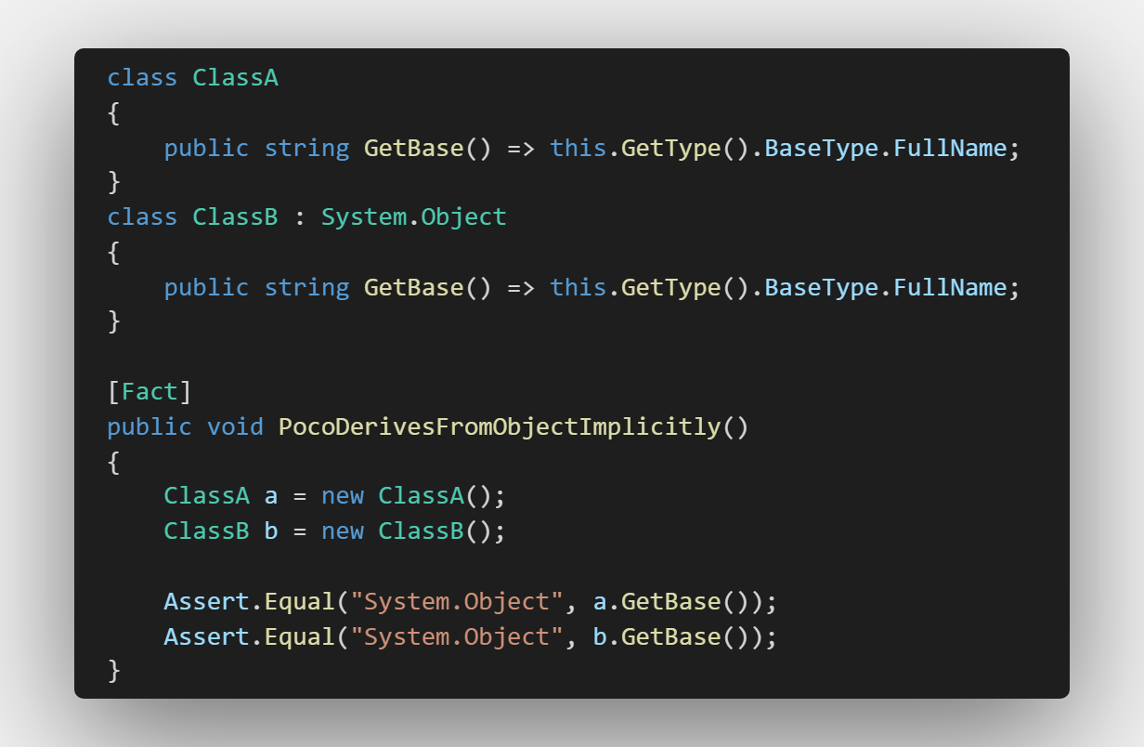
.NET System.Object
System.Object is the base blueprint for all .NET classes and is at the root of the type hierarchy.
The derivation is implicitly done for you by your .NET language of choice.

Slide 4
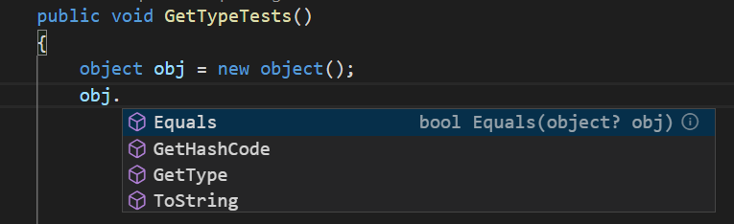
What does the blueprint have?
GetType
ToString
ReferenceEquals
Equals
GetHashCode
MemberWiseClone

Slide 5
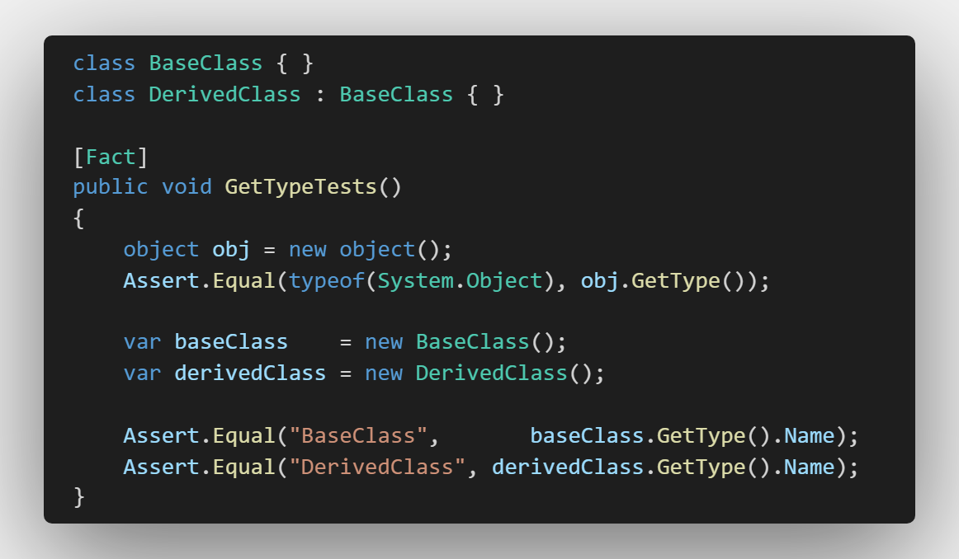
GetType
Returns a System.Type
Synonymous: typeof()
System.Type
Represents type declarations
Is the root of System.Reflection
MSDN for System.Type

Slide 6
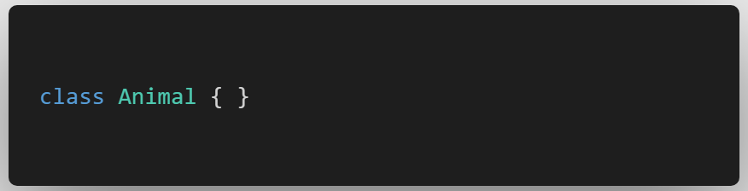
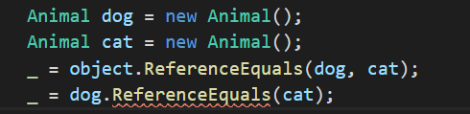
ReferenceEquals
Can only be used as a static method.

Slide 7
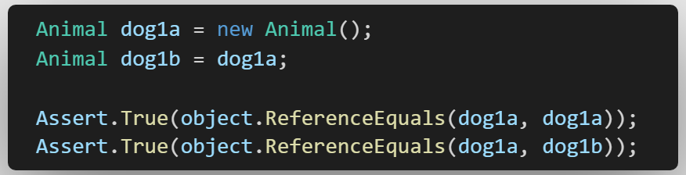
ReferenceEquals
Returns true if both instances are the same instance

Slide 8
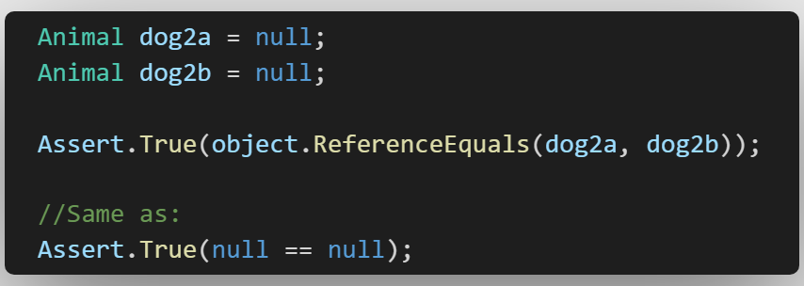
ReferenceEquals
Returns true if both instances are null

Slide 9
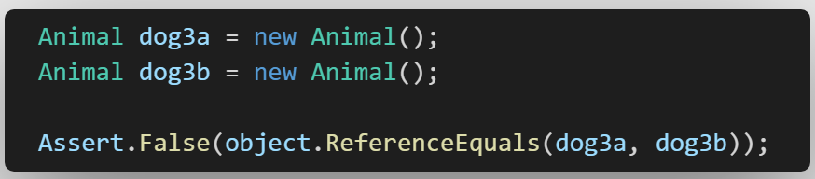
ReferenceEquals
Returns false if both instances are different instances

Slide 10
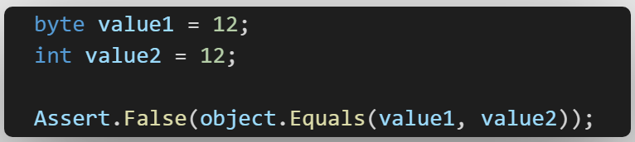
Equals (Value Types)
Returns false if both instances are different types

Slide 11
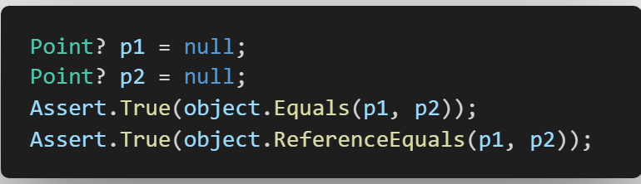
Equals (Value Types)
Returns true if both instances are null

Slide 12
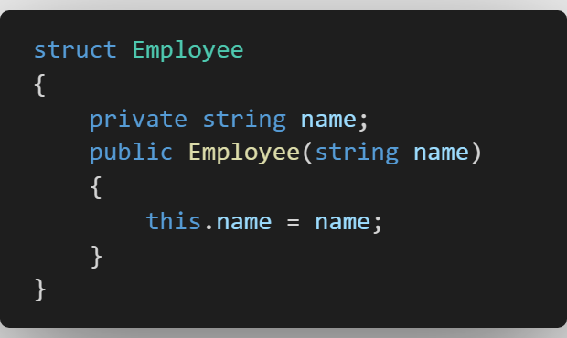
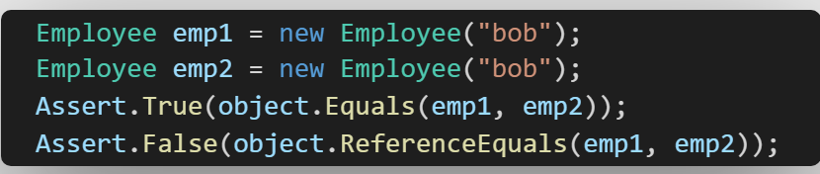
Equals (Value Types)
Compares all private and public members by value
Always use IEquatable<T> with value types

Slide 13
Override Equals (Value Types)
No default for == and != operators!
Unless you define them, you can’t use ==.

Slide 14
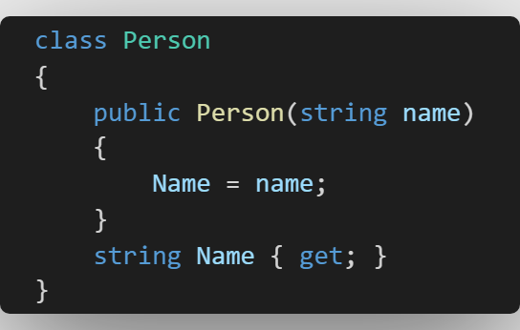
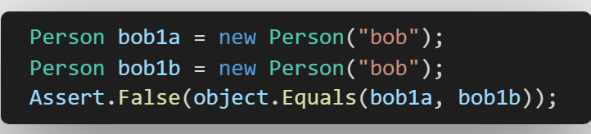
Equals (Reference Types)
Does not compare by value
Equivalent of
ReferenceEquals

Slide 15
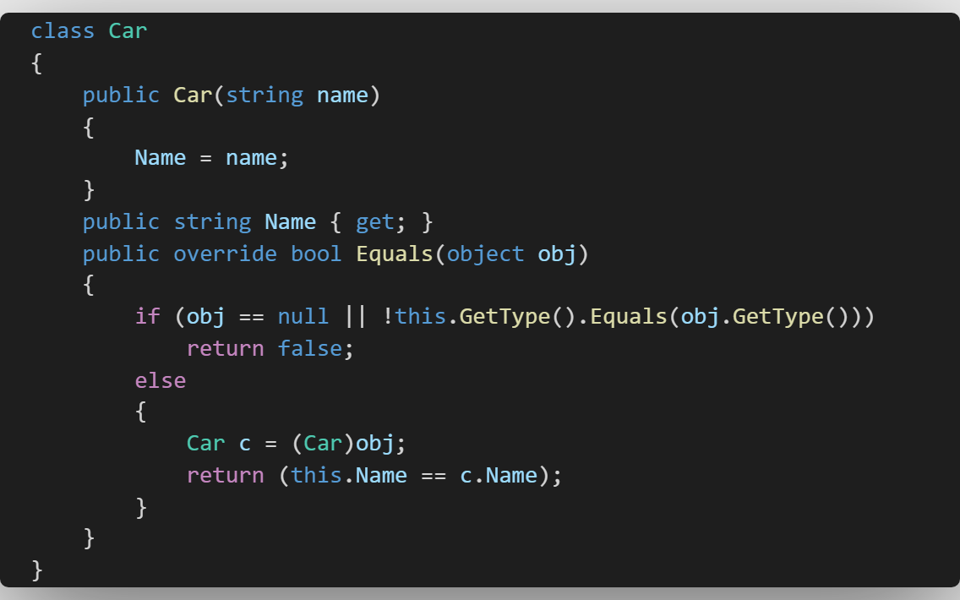
Overriding Equals
Note: Compiler Warning
“Car overrides Object.Equals(object o) but does not override Object.GetHashCode()”
If you had treat all warnings as errors turned on, this would be an error!
We’ll circle back to GetHashCode!

Slide 16
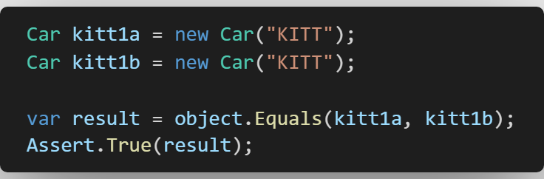
Overriding Equals
Calling
object.Equals(objA, objB)
in this example will call our override once for each Car instance.

Slide 17
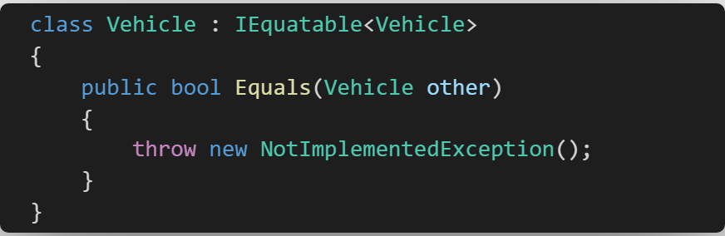
IEquatable<T>
IEquatable<T> asks us to implement a single method.
We can leverage this to offload having to do type checking in our original override

Slide 18
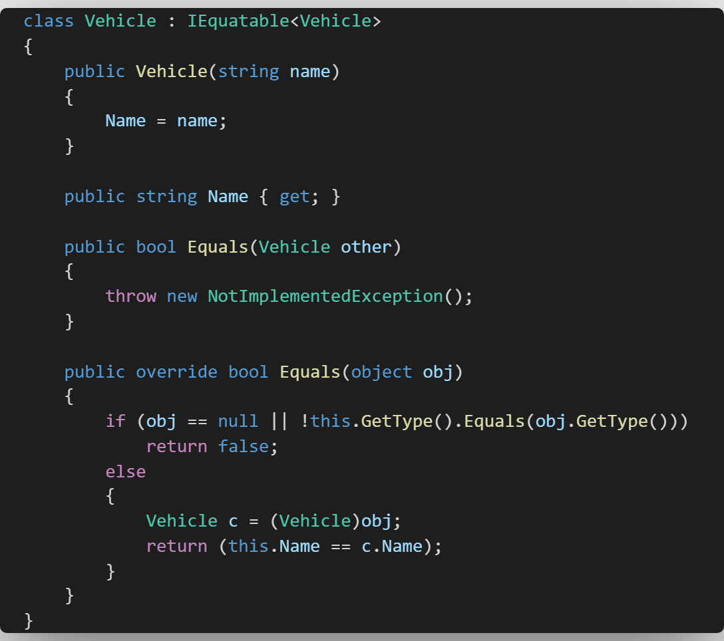
IEquatable<T>
IEquatable<T> asks us to implement a single method.
We can leverage this to offload having to do type checking in our original override

Slide 19
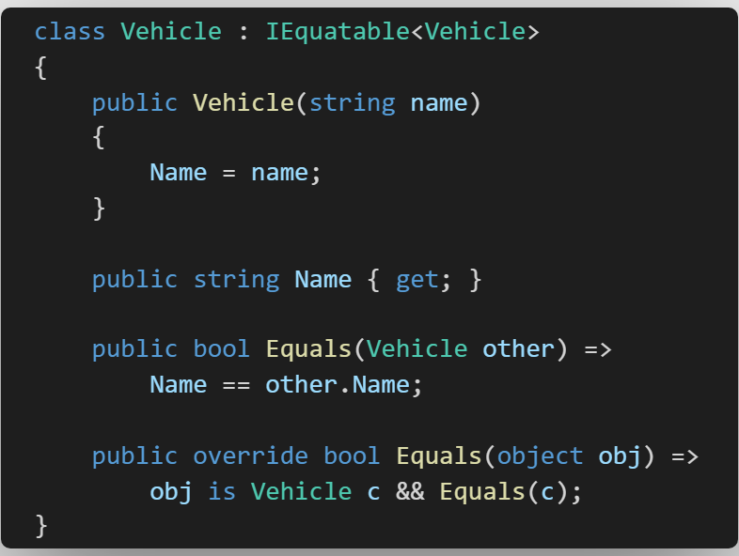
IEquatable<T>

Slide 20
GetHashCode
Remember the Car class 5 slides back?
The compiler told us that if we override Equals, we also need to override GetHashCode
But why?
“
Once you strip away the syntactic sugar our programming languages essentially boil down to three things: sequence, selection and iteration, and every construct within those languages is some combination of them.
” – Robert C. Martin

Slide 21
Collections
It takes time to iterate and select an item out of a big collection.
Collections like Dictionary and Hashtable are really fast at it because maths.
To do their jobs, they require a hash code.
“The trick is to trade a small amount of increased memory burden for a huge amount of increased speed. The idea is to make many shorter lists, called “buckets”, and then be clever about quickly working out which bucket we’re looking at”
Eric Lippert
For most real world scenarios these collections can select an element in O(1) time.
To keep doing their job well, they need us to not muck up the hash code.
Notes:
https://ericlippert.com/2011/02/28/guidelines-and-rules-for-gethashcode/

Slide 22

MSDN
A hash function must have the following properties:
If two objects compare as equal, the GetHashCode method for each object must return the same value. However, if two objects do not compare as equal, the GetHashCode methods for the two object do not have to return different values.
The GetHashCode method for an object must consistently return the same hash code as long as there is no modification to the object state that determines the return value of the object's Equals method. Note that this is true only for the current execution of an application, and that a different hash code can be returned if the application is run again.
For the best performance, a hash function must generate a random distribution for all input.

Slide 23
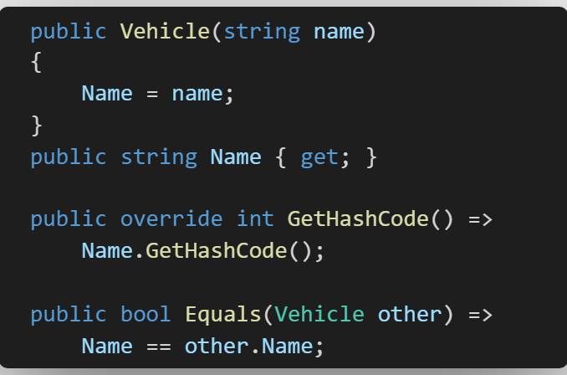
GetHashCode (Single Property)

Slide 24
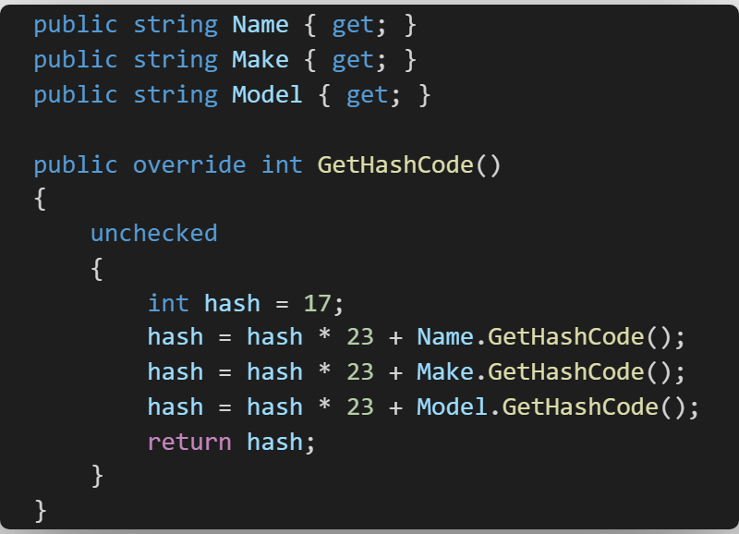
GetHashCode (Two or more properties)
Recommended on StackOverflow
Hard coded numbers?
Unchecked?

Slide 25
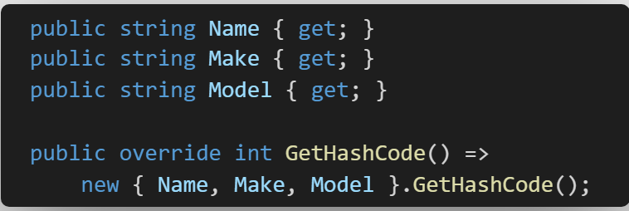
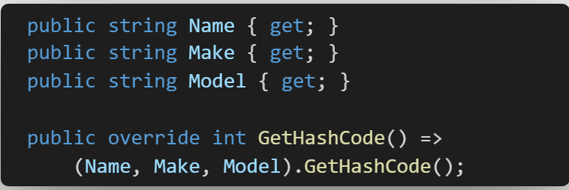
GetHashCode (Free Range Syntactic Sugar)
Anonymous Method
ValueTuple (C# 7)
But wait, there’s more

Slide 26
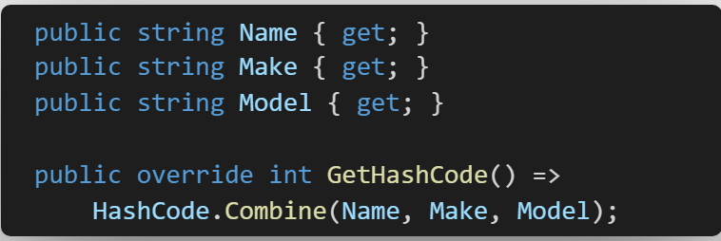
GetHashCode (Gluten Free Syntactic Sugar)
.NET Standard 2.1
HashCode.Combine()
Also has support for hashing collections.

Slide 27

GetHashCode (Mutable)
Don’t override Equals and GetHashCode on mutable types!
But if really insist, here’s the right way.
Sacrifices efficiency for correctness.
Pretty sure this is O(N^2)

Slide 28
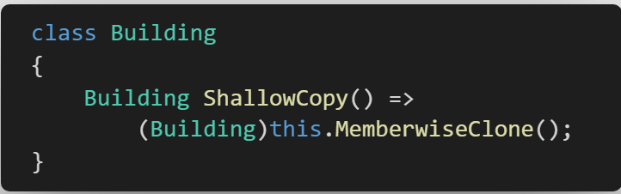
MemberwiseClone
MemberwiseClone is a protected method, so you’re only going to run into it within your type definition.

Slide 29
Shallow Copy and naming
A shallow copy:
Creates a new object
Copies non static fields
Copies value types bit-by-bit
Does not create a copy of a reference type, it only copies the reference
Naming is hard
Clone()
Copy()
✓
ShallowCopy()
DeepCopy()

Slide 30
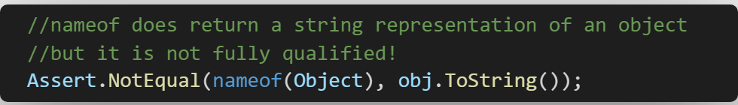
ToString
Simply put, it’s the string representation of an object
The default implementation is to display the fully qualified name of the type.
Aside:

Slide 31
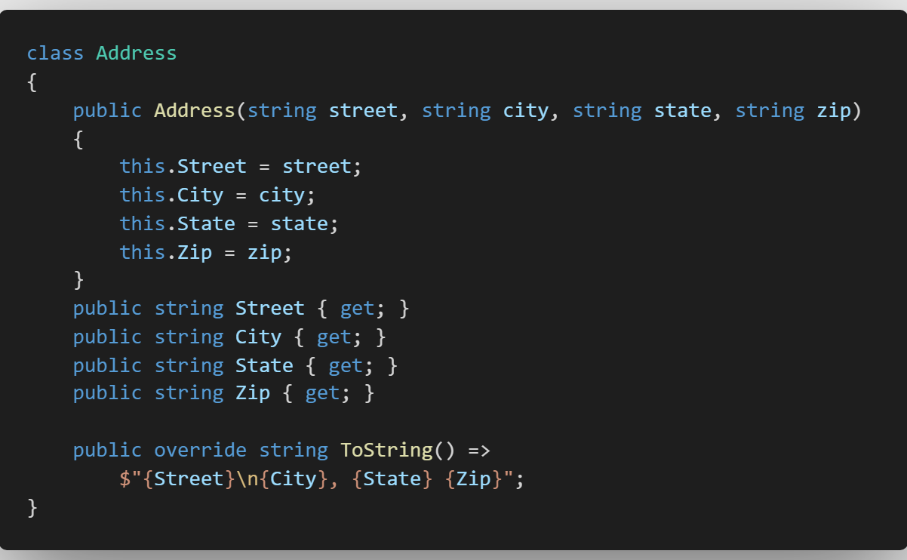
Overriding ToString
We can override the ToString method to format our object for display.
Output:
1 River Rd
Schenectady, NY 12345

Slide 32
Overriding ToString
Do not throw an exception in ToString()
No side effects
Why? No one is going to look there for a bug.

Slide 33


Slide 34
When should we override …
ToString()
Debugging – Use [DebuggerDisplay] Attribute.
Cultural – Defaults to CurrentCulture, so don’t override by itself, use the IFormattable interface
Serialization – Let me catch you using ToString() to spit out JSON…
Equals()
DTOs – Never
Mutable objects – !Nike
Entities – Nope. Your data access layer doesn’t need business logic in it.

Slide 35
In Conclusion
System.Object has some methods on it.
You probably won’t ever need them.
You can override some of them, but you probably don’t need to.
If you do override Equals, consistency is key. Override
If you find yourself overriding the default behavior with some other behavior, make a new method with a good name.
If you truly need to do something clever, test it.

Slide 36
Stack vs Heap
Stack
Extremely Fast
Managed by the CPU
Last In First Out (LIFO)
Regions of Memory
Heap
Very Fast
Help from the GC
Responsibility is on you.

